Slide 1
Finding your procedures for your logbook
Conor Foley May 2022

Slide 2
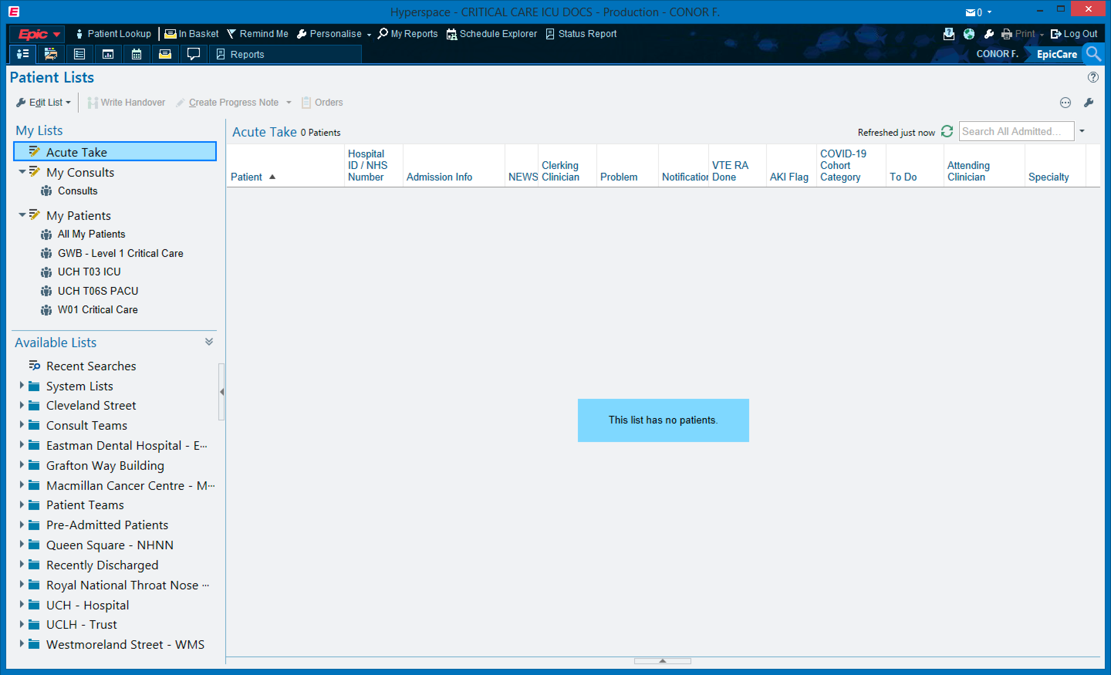

Slide 3
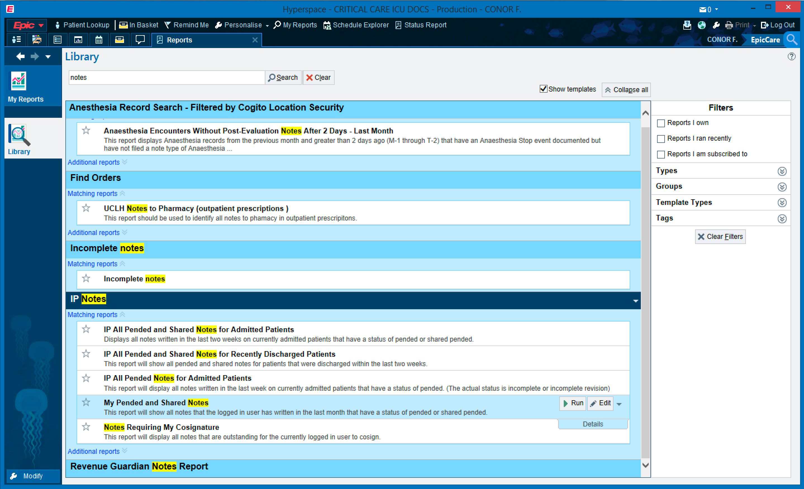
1
2

Slide 4
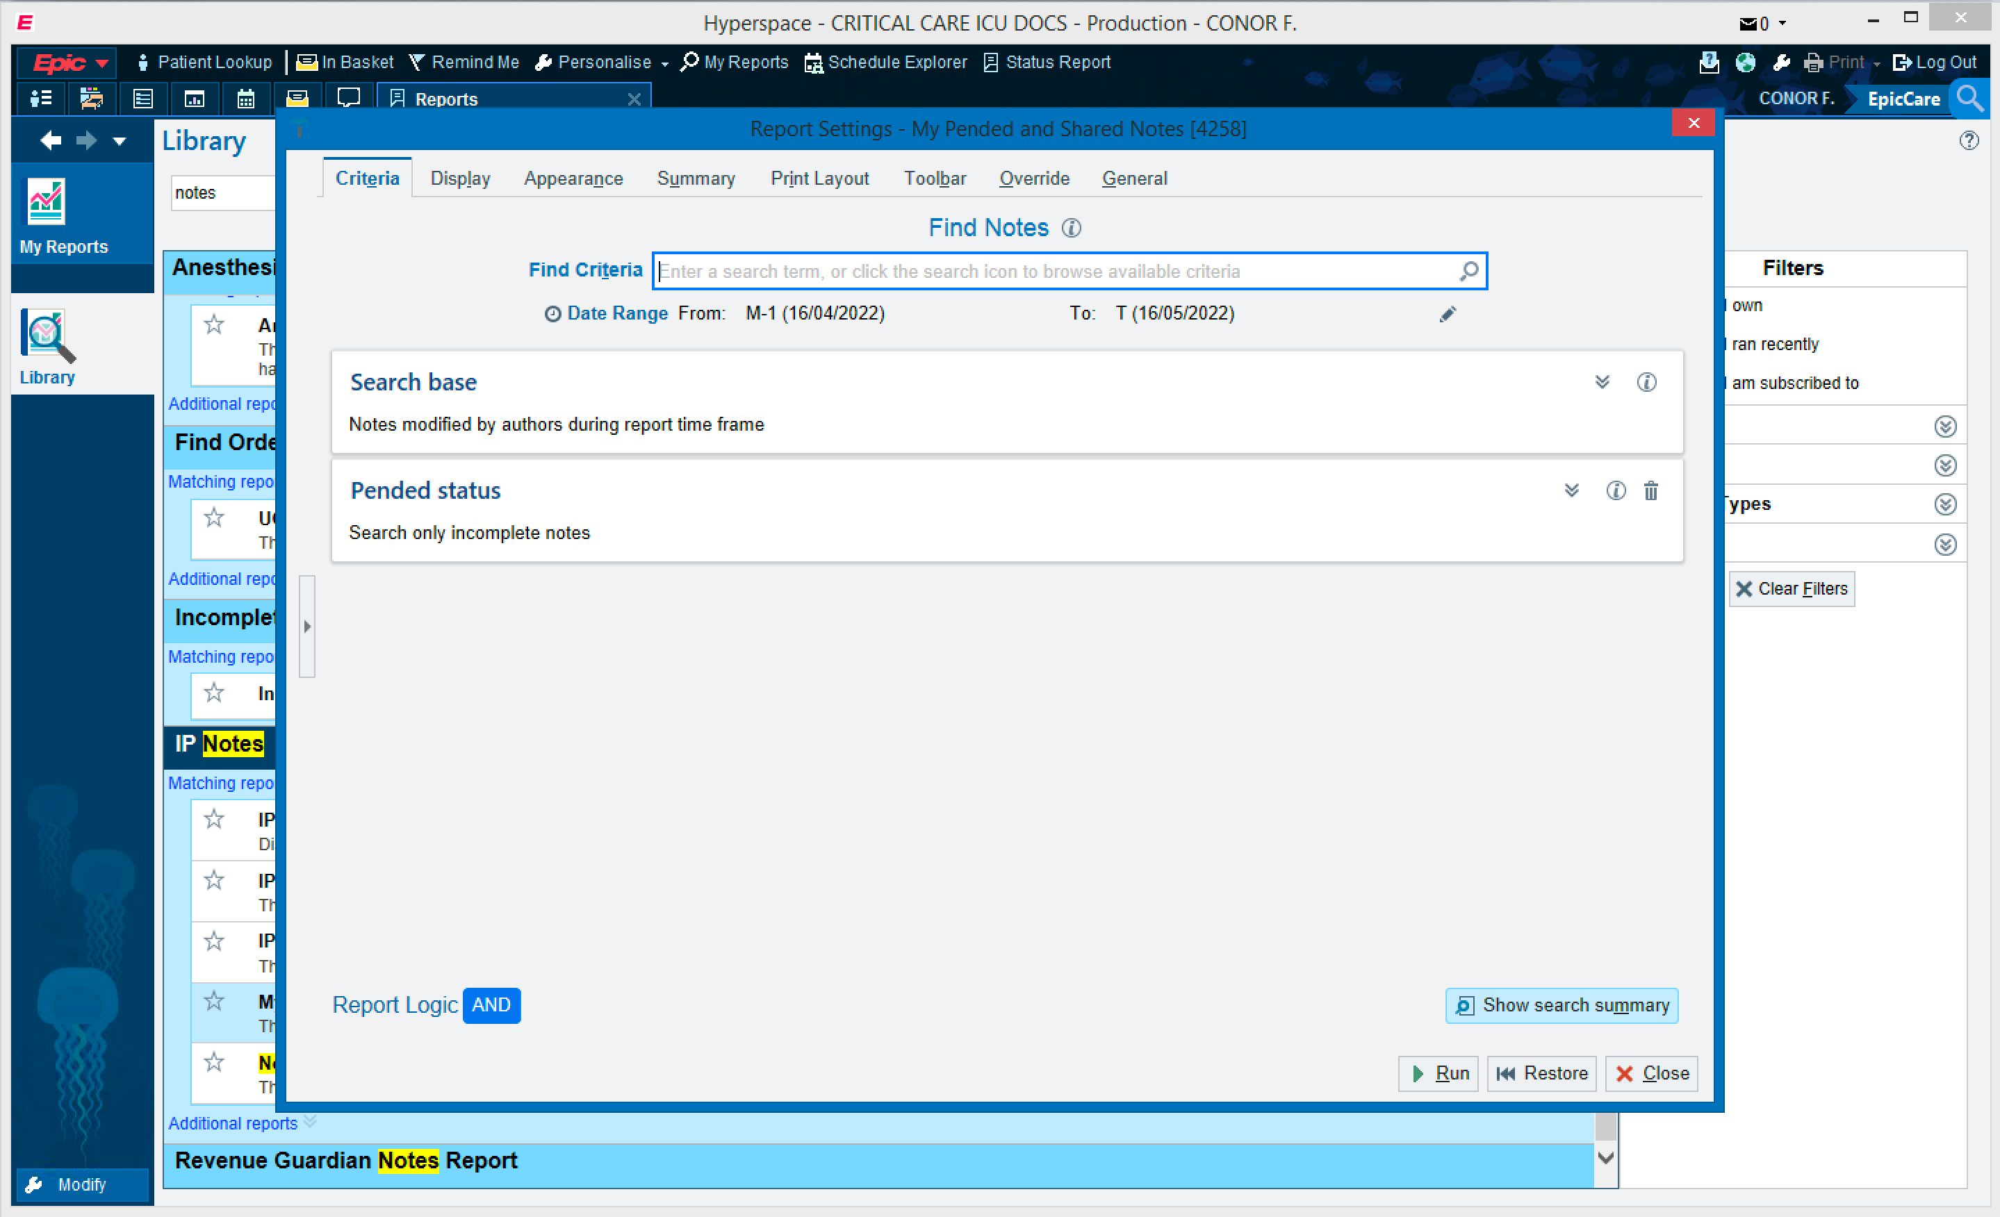

Slide 5
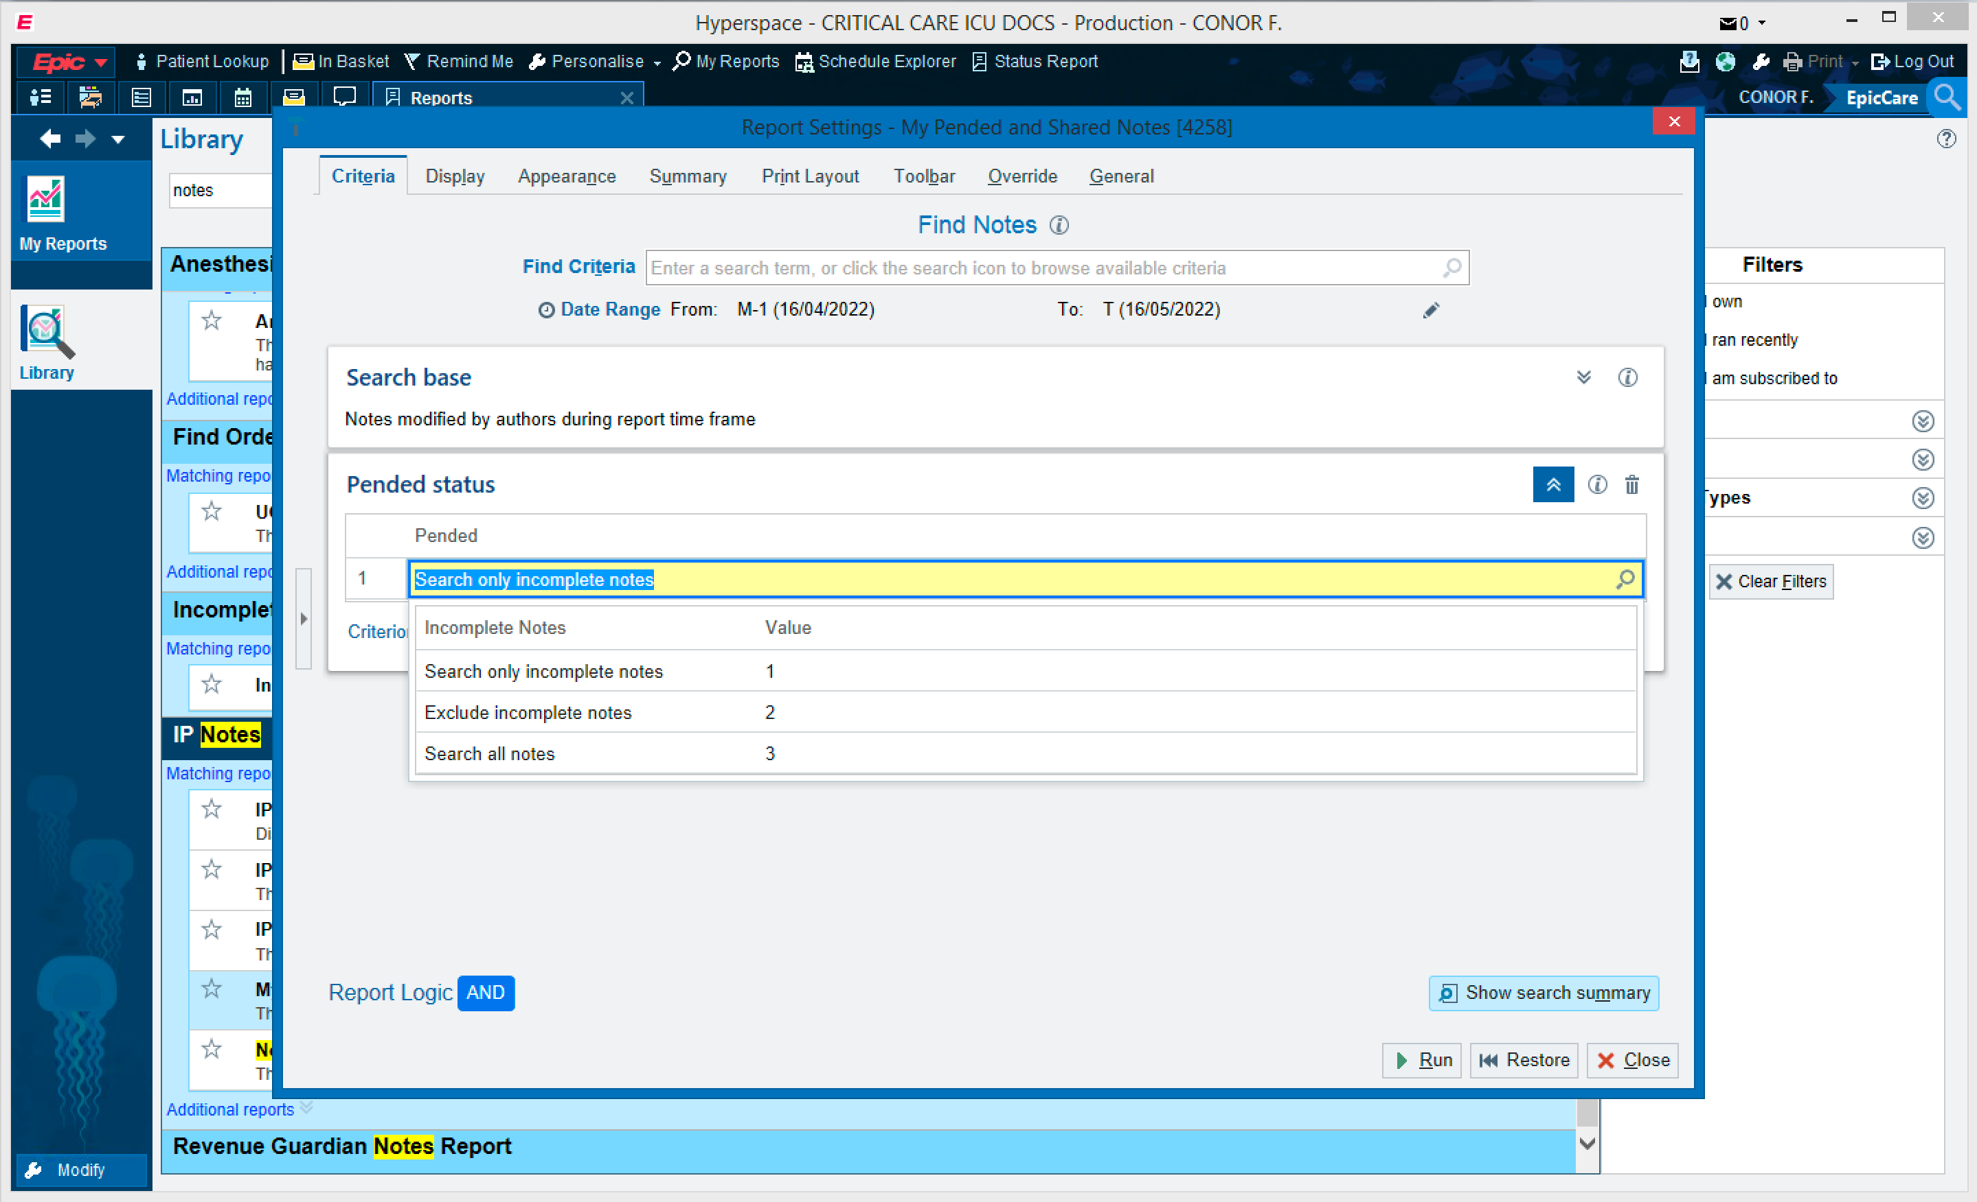

Slide 6

Change time period

Slide 7
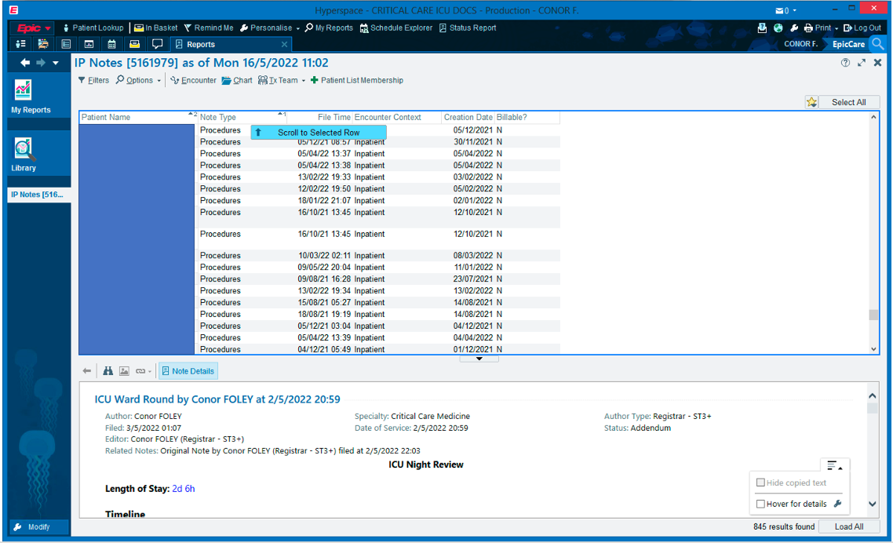
Order by note type

